Slide 1
Using JS With HTML
Basics | Window Object | Using the Console | Loading JS With An External File | Loading JavaScript with async and defer
Notes:
Welcome to our lecture on how to use JavaScript with HTML. In this lecture, we will go through basics of handling JS with html, window objects, how to use console, how to load JS with an external file, and loading JavaScript with async and defer. Let’s start the lecture.

Slide 2

Basics
JavaScript adds interactivity to webpages.
DOM represents the webpage and allows JavaScript to modify it.
JavaScript runs in <script> and executes in the browser.
Notes:
JavaScript is a powerful programming language that adds interactivity to webpages. It works with the Document Object Model or DOM which represents the webpage structure allowing JavaScript to modify it dynamically. JavaScript code runs inside script tags and executes in the browser. This makes it essential for creating dynamic and interactive web applications.

Slide 3
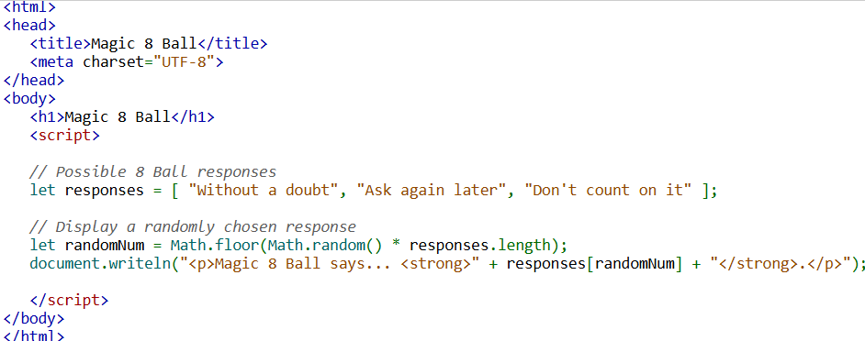
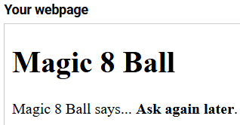
Example
Notes:
This is an example of using JavaScript to create a simple Magic 8 Ball program. The script defines an array of possible responses. It then generates a random number and selects a response from the array. The chosen response is displayed dynamically on the webpage. This demonstrates how JavaScript can manipulate content on a webpage and make it interactive.

Slide 4
Windows Object Properties
JavaScript running in a web browser has access to the window object, which represents an open browser window. properties of the window object include:
window.location holds the current URL info (e.g., window.location.hostname).
window.navigator stores browser details (e.g., window.navigator.userAgent).
window.innerHeight & window.innerWidth give the window's content size in pixels.
Notes:
Now we will explore JavaScript object properties that provides access to the window object which represents the browser window. Key properties include window location which gives the current URL window navigator which stores browser details and window inner Height and inner Width which provide the window size in pixels. These properties help developers interact with and retrieve information about the browsing environment.

Slide 5
Windows Object Methods
The window object defines some useful methods:
window.alert() shows an alert box with a message.
window.confirm() displays a confirmation box with OK/Cancel.
window.open() opens a new browser window with a URL.
Notes:
The window object provides several useful methods for user interaction. Window alert displays an alert box with a message. Window confirm shows a confirmation box with OK and Cancel buttons. Window open allows opening a new browser window with a specified URL. To enhance the presentation, add a smooth fade transition when moving from one slide to the next for a better viewing experience.

Slide 6
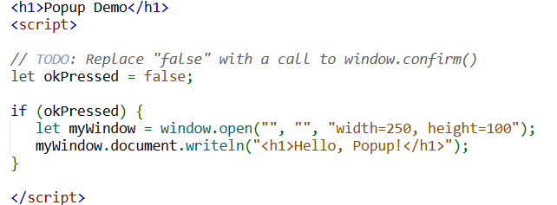
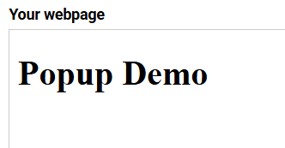
Example
Notes:
This example demonstrates how to create a popup window using JavaScript. The script initially sets a variable to false but can be updated to use window confirm for user input. If the user confirms a new window opens with specific dimensions displaying a message. This highlights how JavaScript can interact with users and modify window behavior dynamically to enhance web functionality.

Slide 7
Using JS With Console
Console shows debugging output without affecting the webpage. Open with Ctrl+Shift+J (Win/Linux) or Cmd+Opt+J (Mac).
Errors appear in the console for syntax or runtime issues (e.g., Document.writeln() typo).
Keep the console open to quickly spot and fix JavaScript errors.
Notes:
The browser console is a useful tool for debugging JavaScript without affecting the webpage. It displays messages errors and warnings. Open it using keyboard shortcuts. Errors appear in the console when there are syntax or runtime issues making it easier to identify problems. Keeping the console open helps developers quickly debug and fix JavaScript code ensuring smooth execution of scripts.

Slide 8
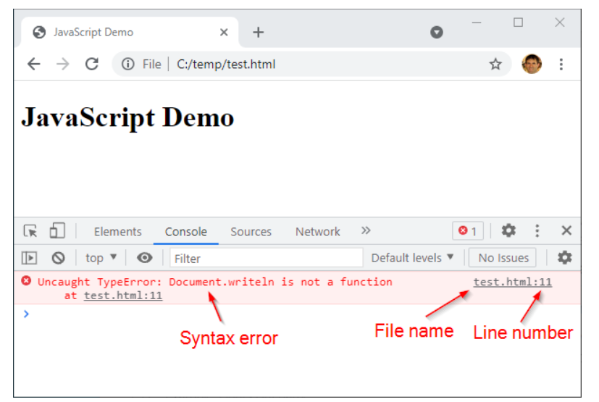
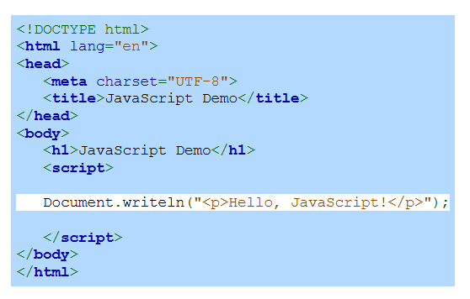
Chrome console showing a syntax
Notes:
This example shows how the Chrome console helps identify syntax errors in JavaScript. In this example a mistake in the code causes an error message to appear in the console. The console provides details such as the type of error the file name and the line number where the issue occurs. Using the console for debugging helps developers quickly find and fix errors improving code reliability and performance.

Slide 9
Using JS With Console
The console object has predefined methods (API) that define how programmers interact with it. The console API includes the following methods:
console.log() prints info to the console.
console.warn() shows warnings (yellow indicator).
console.error() displays errors (red indicator).
console.dir() logs objects in an expandable tree format.
Notes:
The console object provides useful methods for debugging in JavaScript. Console log prints information to the console. Console warn displays warnings with a yellow indicator. Console error shows errors in red helping to identify issues. Console dir logs objects in an expandable tree format for better inspection. Using these methods makes debugging easier and helps developers track issues efficiently.

Slide 10
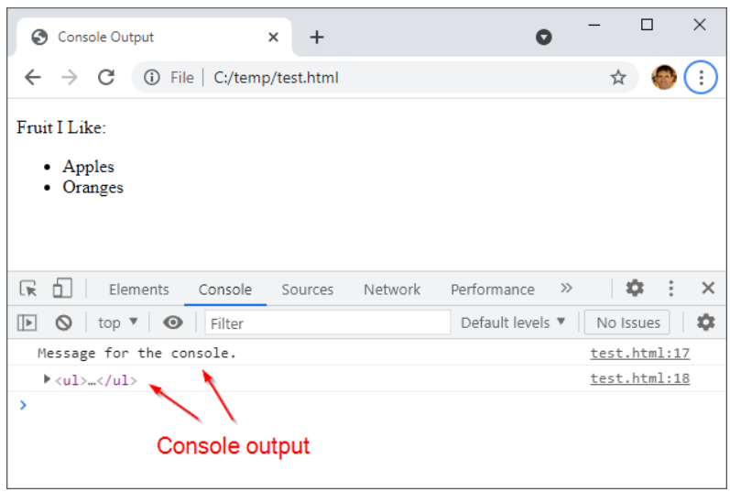
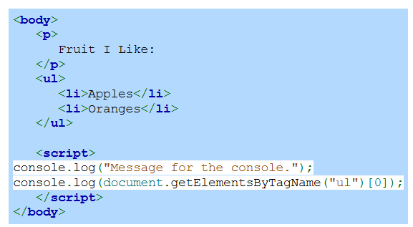
console.log() output example
Notes:
The example shows console object provides useful methods for debugging in JavaScript. Console log prints information to the console. Console warn displays warnings with a yellow indicator. Console error shows errors in red helping to identify issues. Console dir logs objects in an expandable tree format for better inspection. Using these methods makes debugging easier and helps developers track issues efficiently.

Slide 11
Loading JS from An External File
Small scripts can be written directly in HTML.
For larger projects, use external JavaScript files for better organization.
Load external scripts using <script src="file.js"></script>.
Notes:
JavaScript can be included in HTML in two ways. Small scripts can be written directly inside script tags within an HTML file. However, for larger projects using external JavaScript files helps keep the code organized and manageable. External scripts are linked using the script tag with the SRC attribute pointing to the file location. This approach improves code reusability and maintainability.

Slide 12
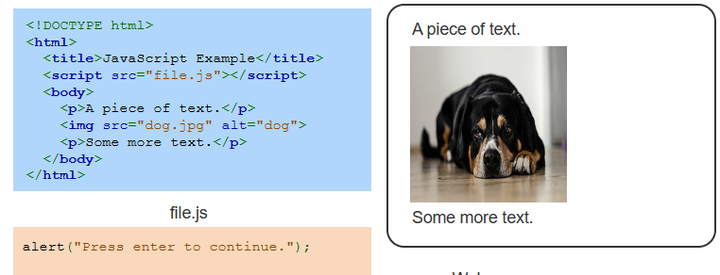
Example
Notes:
This example shows how to use an external JavaScript file in an HTML document. The script tag links the external file which contains a simple alert function. When the page loads the JavaScript file runs displaying a message. The HTML also includes text and an image demonstrating how JavaScript can be added without mixing it with HTML ensuring better organization and maintainability of code.

Slide 13
Loading JavaScript with async and defer
Place <script> in the <head> with async or defer for better performance.
async loads and runs JavaScript while the page loads, running scripts as soon as they’re ready.
defer loads JavaScript while the page loads but waits to execute it until the page is fully loaded.
Notes:
As we move forward in optimizing webpage performance let us explore how JavaScript loads efficiently. When adding scripts placing them in the head with async or defer enhances performance. The async attribute loads and runs JavaScript while the page loads. The defer attribute loads the script but waits to execute it until the page is fully loaded ensuring smooth execution and better page speed.

Slide 14
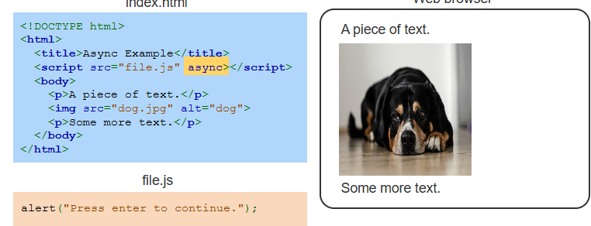
Example
Notes:
Now let us look at an example of using the async attribute when loading JavaScript. In this HTML file the script tag includes async which allows the JavaScript file to load while the page content is being processed. The external script contains an alert message that runs as soon as it loads. This approach can improve page performance by reducing delays in script execution. Thanks for watching the lecture.

